Slide 1
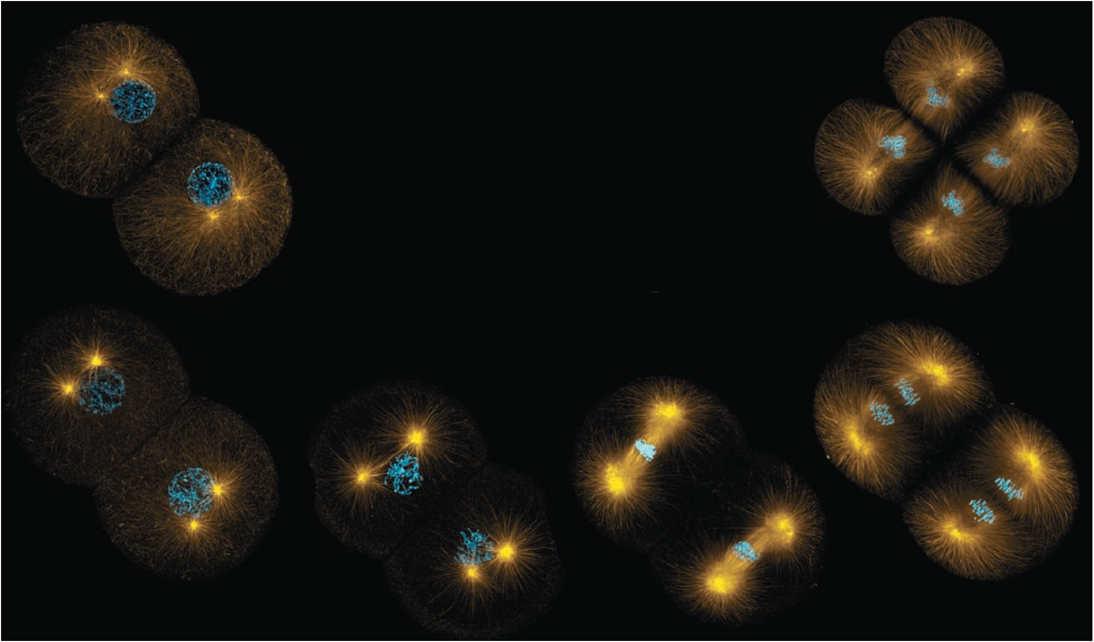
Mitosis and Meiosis
Experiment No. 7

Slide 2
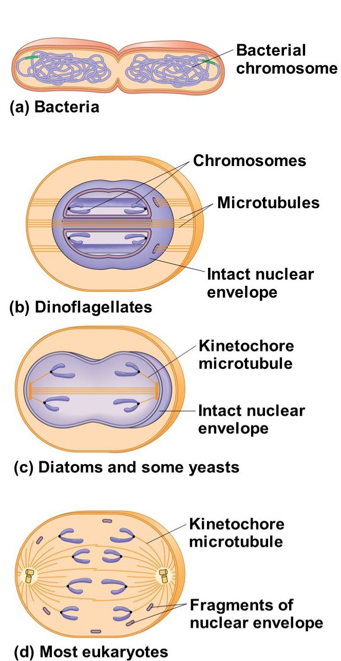
The continuity of life is based on the reproduction of the cells ( Cell division )
Cell division: differ According to the type of organisms:
Prokaryotic organism ( Bacteria ): Binary fission, division in half.
Unicellular algae ( Dinoflagellates): Nuclear envelope remains intact during the cell division and the
chromosome attached to the nuclear envelope.
Unicellular algae (Diatoms): Nuclear envelope remains intact during the cell division and the spindle
Form within nucleus.
Most other Eukaryotes (Includes Plant and Animals): Mitosis and Meiosis

Slide 3
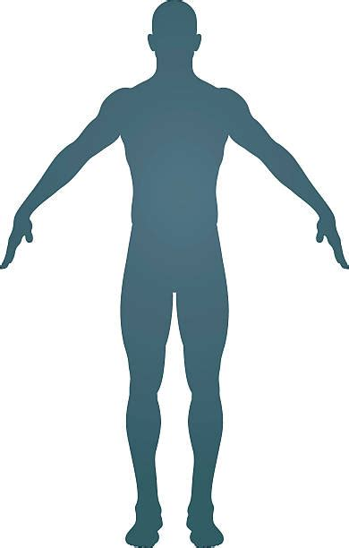
Human body contains:
Somatic cells Germ line cells (sex cells)
Contain the diploid (2n) chromosomes number.
Divide by mitosis to produce two genetically identical daughter cells.
i.e. liver cells, muscle cells, skin cells, etc.
Contain the diploid (2n) chromosomes number.
Divide by meiosis genetically different gametes.
Oogonium and spermatogonium .

Slide 4
Why do cells divide?!
Cells divide for many reasons. For example,
Mitosis
To renewal, repair, and replace old, dead, or damaged cells.
For growth and development of multicellular organisms.
Meiosis
To have genetic diversity in all sexually reproducing organisms.
Creates sex cells (gametes)
Asexual reproduction

Slide 5
Mitosis: is the shortest stage of cell cycle.
The cell cycle: is an ordered sequence of events that extends from the time a cell is first
formed from a dividing parent cell until its own division.
In the cell cycle of a dividing cell, the mitotic (M) phase alternates with interphase.

Slide 6
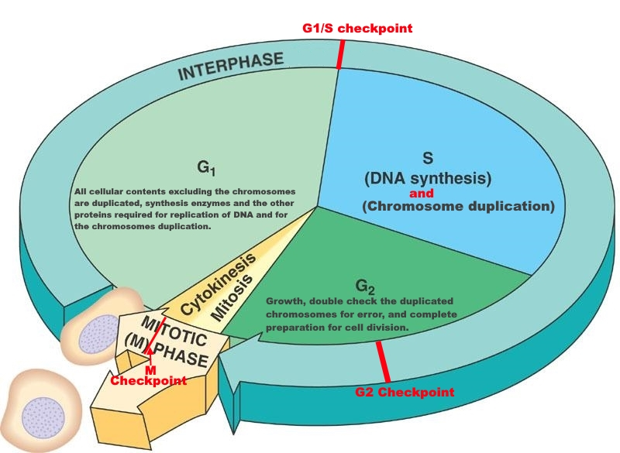
Cell Cycle
Divided into three main stages:
Interphase:
Before a dividing cell enters mitosis, it undergoes a period of growth called interphase.
About 90% of a cell's time in the normal cell cycle may be spent in interphase.
Interphase including G1, S and G2 sub phases.
Mitotic phase: includes both, mitosis and cytokinesis.
Mitosis: one copy of the DNA is distributed into each of its
daughter cells
Cytokinesis: the cytoplasm divides and organelles are distributed into
the two new cells

Slide 7
Interphase
G1 (first gap): cell were metabolically active, synthesizing enzymes and
other proteins, and producing cytoplasmic organelles.
G1 (G1/S) checkpoint: to ensure that everything is ready for
DNA synthesis
S (synthesis): where DNA replication (DNA synthesis) and chromosomes
duplication occur
G2 (second gap) :cell grows more and more to complete its preparation
for cell division.
G2 checkpoint: to ensure the cell ability to proceed into mitosis.
G0: non dividing stage: where some cells in multicellular organisms spent their time if they divided very infrequently or not at all, these cells can’t over come the G1/S checkpoint.

Slide 8
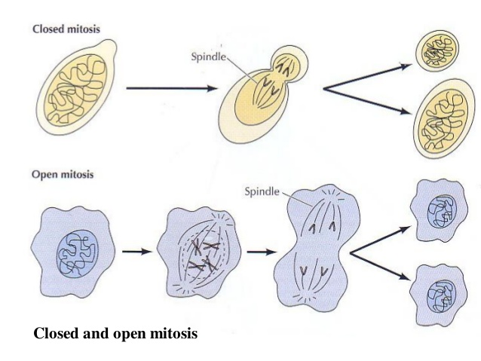
Mitosis
Mitosis: is the phase where chromosomes in the nucleus are evenly divided producing two daughter cells with identical genetic material are produced. It is two types:
Closed and open mitosis
Open mitosis: occur in most multicellular eukaryotic organisms where the microtubules invades the nuclear space.
Closed mitosis: occur in unicellular eukaryotic
organisms (i.e, yeast, fungi, algea, etc.) where
the spindles forms inside the nucleus or penetrate
the intact nuclear envelope.

Slide 9
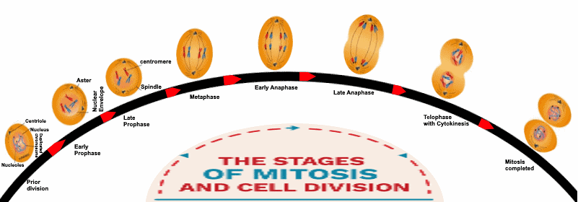
Stages of Mitosis

Slide 10
Prophase
Chromatin fibers become coiled and condenses into discrete chromosomes.
Each chromosome having two chromatids joined at a centromere.
Centrosomes polymerized help in forming the mitotic spindle apparatus (plants have no Centrosomes).
The spindle fibers elongate and the two centrosomes get apart from each other and each one move to the opposite pole of the cell.
Nucleolus disappears
The nuclear envelope disintegrates and disappear.
Mitotic spindle begins to form .
Animal cell
plant cell

Slide 11
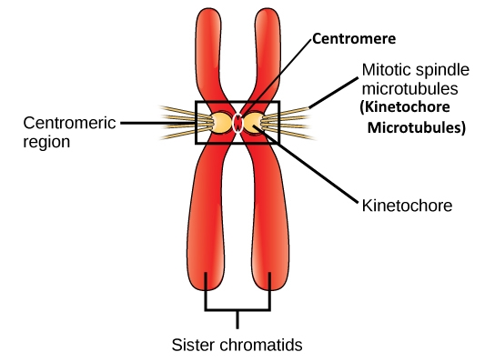
Sister Chromatids

Slide 12
Metaphase
Animal cell
The nuclear membrane disappears completely.
Chromosomes become shorter and thicker.
Chromosomes move until they attach at their kinetochores to kinetochore microtubules from both sides of their centromeres.
Chromosomes align at the metaphase plate
(Mid plane) of the cell.
plant cell

Slide 13
Anaphase
Shortening of the kinetochore microtubules separate the paired sister chromatids separate.
The paired sister chromatids being moving (separate ) toward opposite ends of the cell as their kinetochore microtubules shorten.
The cell elongate as their non- kinetochore microtubules lengthen and elongate and by sliding of the non kinetochore microtubules over each other at the centre of the cell.
Chromosomes reach their maximal level of condensation (most visible).
Once the paired sister chromatids separate from one another, each is considered a "full" chromosome.
Animal cell
plant cell

Slide 14
Telophase
Here, the events of prophase will be reversed.
Nuclei begin to form at opposite poles.
The nuclear envelopes of these nuclei from remnant pieces of the parent cell's nuclear envelope and from pieces of the endomembrane system.
Nucleoli also reappear.
The chromosomes become less condensed (thread like structure).
Any remaining of spindle microtubules disappear.
plant cell
Animal cell

Slide 15
Cytokinesis the division of the cell's cytoplasm.
Cytokinesis:
It is not a stage of mitosis
In animal cells:
It takes place a process called Cleavage.
Cleavage takes place by furrow formation on the surface of the cell and goes inward.
Cleavage furrow occurs when contractile ring of actin microfilaments associated with the myosin protein contract.
The contraction of microtubules pinching the cells into two daughter cells.
Direction of formation: outward to intward
Direction of formation: cell surface inward

Slide 16
Cytokinesis:
It is not a stage of mitosis
In Plant cells
It takes place by Vesicles formation.
Vesicles derived from Golgi apparatus and move along the microtubules to the centre of the cell, coalesces together to form the cell membrane and the materials of the cell plate deposited in between .
The new plasma membrane fused with the old one.
Then the materials of the secondary cell wall deposit out side the cell plate.

Slide 17
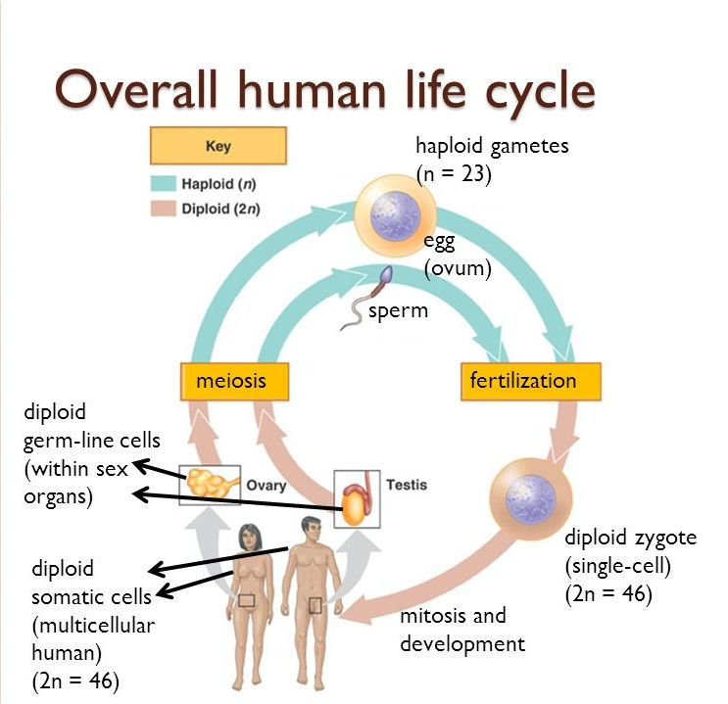
Meiosis
Mitotic division are known as meiosis I and meiosis II that important in traits transmission and gametes production.

Slide 18
During meiosis I, homologous pairs of chromosomes are separated.
During meiosis II, the sister chromatids of each chromosomes are separated (as in mitosis).

Slide 20
Meiosis I- prophase I
As in mitosis,
Centrosome moves to the opposite pole.
Spindle fibers formed
Nucleolus disappear
Nuclear envelope fragmented and disappear
Chromosomes condensed and form sister chromatids.
At late of prophase, chromosomes are further condense and microtubules invading the nuclear envelope attaching to the kinetochore at the centromere.
Main events at prophase I:
Synapsis
Crossing over

Slide 21
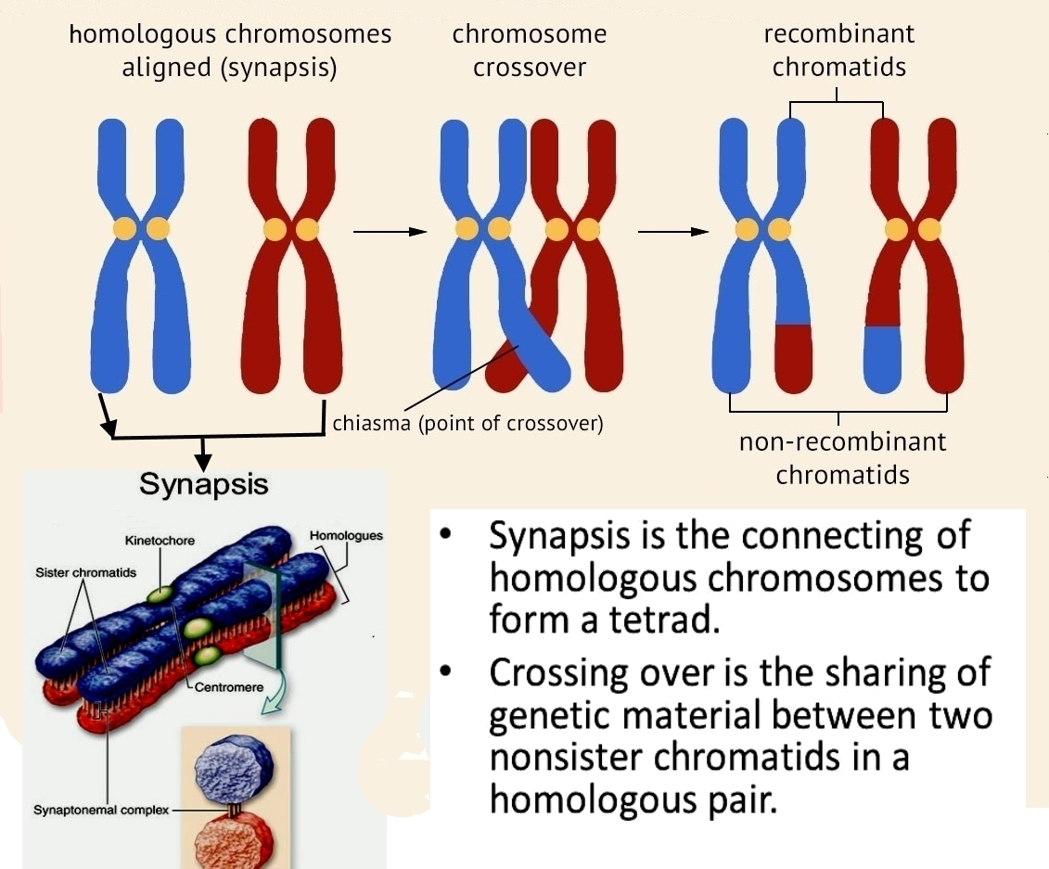
Synapsis and Crossing over

Slide 22
Metaphase I
Alignment of the paired homologous chromosomes on the equatorial plate of the cell in a random orientation along the plate
This random alignment resulting in an independent assortment in order to increase genetic variation

Slide 23
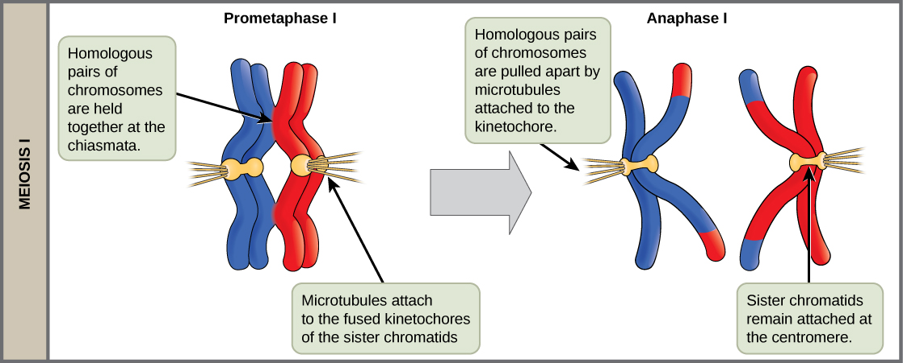
Anaphase I
Homologous pairs separated from each other.
Shortening of kinetochore microtubules moving each pair to the opposite ends of the cell.
Lengthen of the non- kinetochore microtubules aids in cell elongation.

Slide 24
Telophase I and Cytokinesis
At telophase each half of the cell has a haploid set of chromosome with each chromosome consisted of sister chromatids.
Reappearance of nuclear envelope and nucleolus.
Cytokinesis occurs simultaneously with telophase forming two haploid daughter cells

Slide 25
Meiosis II
Is the second mitotic division.
Involve the segregation of sister chromatids.
Similar to mitosis.
Resulted in four haploid daughter cells genetically distinct from each other and from the parent cell.
Meiosis II phases including: Prophase II, Metaphase II, Anaphase II and Telophase II followed by Cytokinesis.

Slide 26
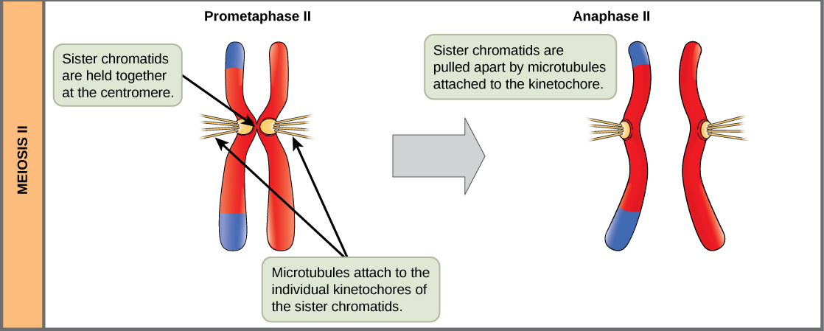
In anaphase II: splitting of centromere takes place and the chromatids separated from each other:

Slide 27
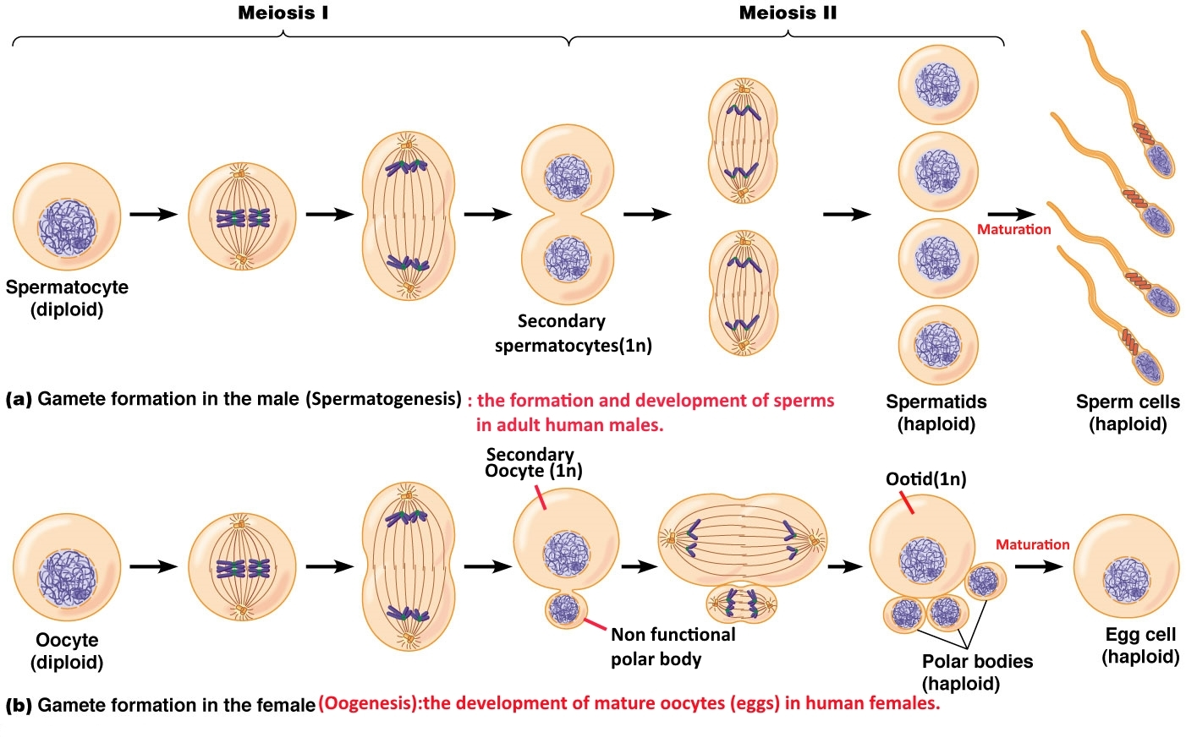
Gametogenesis: The production of gametes.

Slide 28
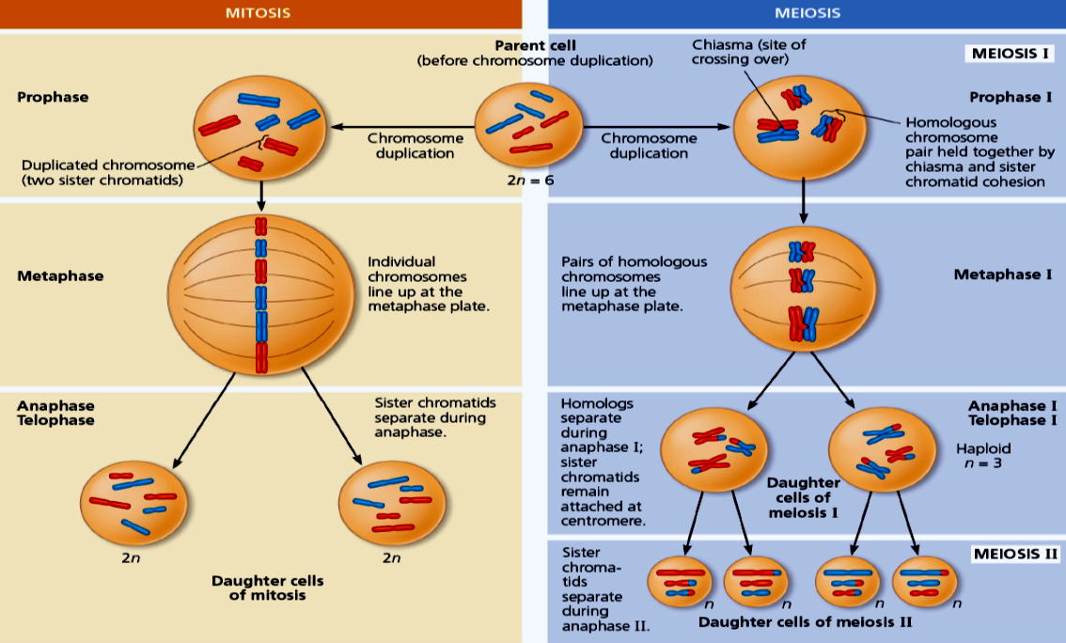
Differences between Mitosis and Meiosis

Slide 29
The Practical part
Study the followings:
Models of Mitosis in plants and Animals
Charts for Meiosis
Examine the mitosis in a slide of Root tip and identify each phase

Slide 30
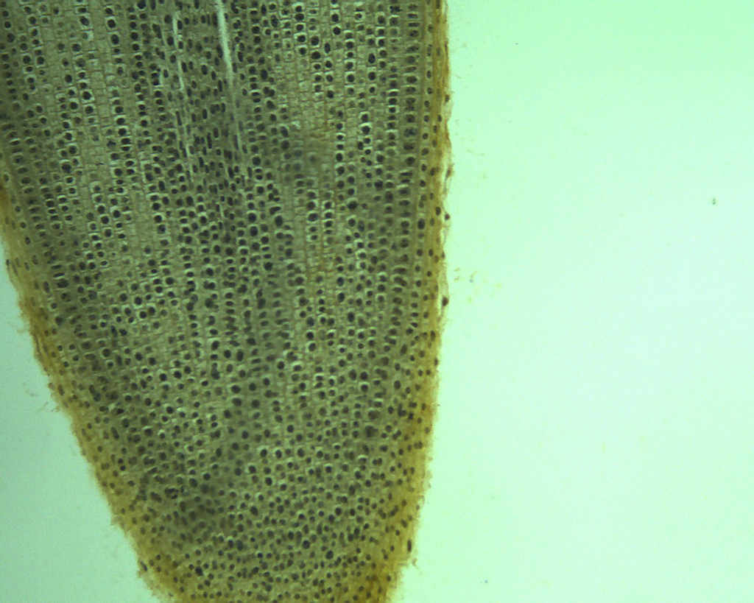
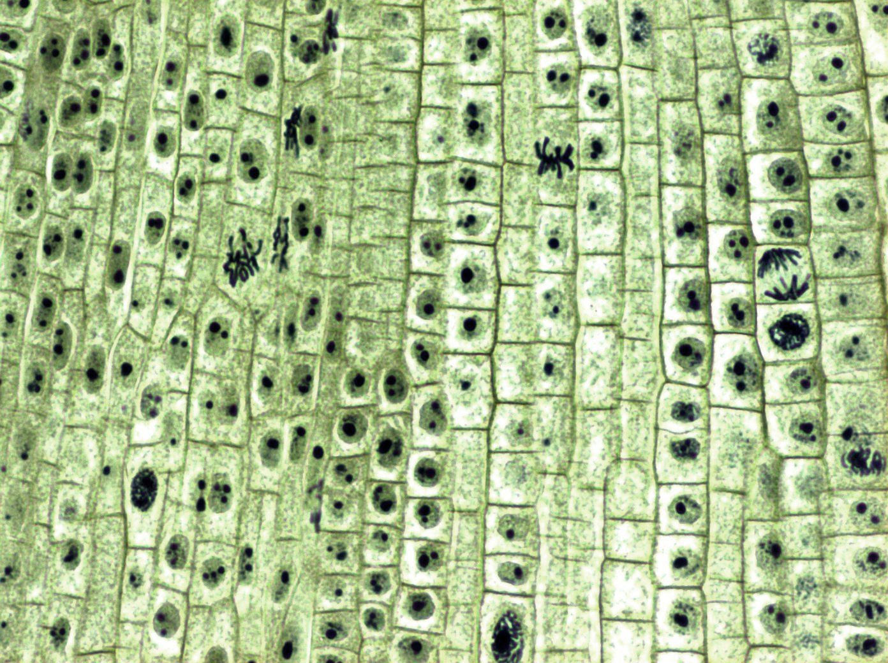
Practical Part
examination a prepared slide of a longitudinal section of an allium (onion) root tip.

Slide 31
The End

